Slide 1
Lecture 6
Sidra Khatoon

Slide 2
Styling Text
There are two topics regarding the appearance of Text: TextStyle and Custom Fonts.
Text Style:
Text widgets have a style property which takes a TextStyle object. You’ll simply set the style property to an instance of a TextStyle widget and set properties. TextStyle supports about 20 properties. Here are the most useful:
• color – Any of the valid 16+ million colors
• decoration – TextDecoration.underline, overline, strikethrough, none
• fontSize – A double. The number of pixels tall to make the characters. Default size 14.0 pixels
• fontStyle – FontStyle.italic or normal
• fontWeight – FontWeight.w100-w900. Or bold (which is w700) or normal (which is w400)
• fontFamily – A string

Slide 3
Styling Text
Custom Font
Certain designers call for custom fonts when they design scenes. In Flutter, using custom fonts is easy to implement, and they work cross-platform.
To style our text,
1: Let's use a custom font Create a new directory called assets/fonts.
2: Copy the font files located at assets/fonts
3: Update our pubspec.yaml file so we can use our fonts.

Slide 4
Understanding Flutter Material Design Themes
A theme in Flutter is a collection of property-value pairs that dictate the appearance of the app’s widgets. ThemeData is the class responsible for holding these properties. Let’s first understand the significance of ThemeData and how it helps in theming.
Theme Data:
The ThemeData class encapsulates a Material Design theme’s colors, typography, and shape properties. We typically use it as an argument for the Material App widget, which in turn applies the theme to all descendant widgets.

Slide 5
Understanding Navigation in Flutter
What is Navigation in Flutter?
Navigation is the act of moving between screens of an app to complete tasks (according to Material Design).
It’s enabled through several means: dedicated navigation components, embedding navigation behavior into content and platform affordances.
Smooth and intuitive navigation ensures that users can find what they need quickly and efficiently, leading to a positive experience.
Conversely, poor navigation can result in frustration and may cause users to abandon the app altogether.

Slide 6
Types of Navigation
There are three types of navigation that are common to all apps – stack, tab, and drawer navigation.
Stack Navigation
Tab Navigation
Drawer Navigation

Slide 7
Stack Navigation
A deck of cards, where you can add or remove cards from the top of the stack.
Stack Navigation in Flutter works in a similar fashion.
It helps you navigate between pages or screens by stacking new pages on top of existing ones.
When you move to a new screen, the current screen is pushed onto the navigation stack, and when you return, the top screen is popped off the stack.
This navigation type is commonly used for hierarchical and linear flows within an app.

Slide 8
Tab Navigation
Tabs are a staple of mobile app navigation, allowing users to quickly switch between different sections or views without losing their current context.
Flutter makes it easy to implement tabbed navigation with its built-in widgets, such as TabBar and TabBarView.
By using these widgets, you can create a beautiful and functional tab navigation experience, perfect for organizing content into logical sections.
You also have the freedom to customize the appearance of your tabs, making it simple to create a unique look and feel for your app.

Slide 9
Drawer Navigation
The Drawer Navigation pattern, also known as the "hamburger menu" or "side menu," is a popular navigation style in mobile apps.
It consists of a hidden panel that slides out from the side of the screen, revealing a menu with various navigation options.
This space-saving technique keeps your app's main content visible while providing easy access to additional features or sections.

Slide 10
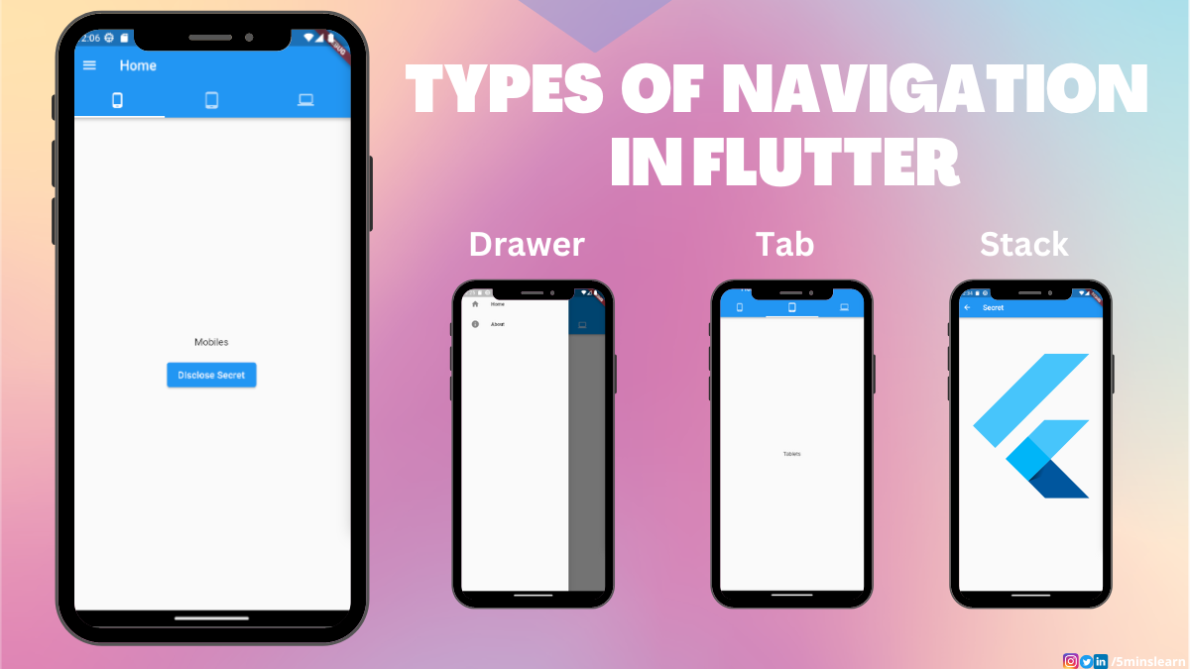

Slide 11
Key Concepts of Navigation in Flutter
The Flutter framework provides developers a way to navigate around the app with two main navigating classes that can be understood exactly to their names: Route and Navigator. Route acts as the screen and Navigator acts as the operator to manage Route.
Route
In Flutter, a Route is an abstraction for a screen or page that can be navigated to. It represents the transition from one screen to another and is managed by the Navigator widget, which maintains a stack of routes.
Here is some common Route implemented class in Flutter:
MaterialPageRoute includes built-in transitions that comply with Material Design guidelines, such as a fade transition combined with a scale transition, providing a seamless and smooth user experience. The transitions are subtle and polished, enhancing the overall aesthetics of the application without the need for custom animations.
CupertinoPageRoute is specifically intended for apps that adhere to Cupertino design guidelines, which are Apple’s design language for creating elegant, clean, and intuitive user interfaces. It ensures that the app’s navigation behavior is consistent with other iOS applications, providing a familiar user experience for iOS users.
PageRouteBuilder is a powerful and flexible class in Flutter that allows developers to create custom route transitions. Unlike MaterialPageRoute and CupertinoPageRoute, which provide predefined transitions based on Material Design and Cupertino (iOS) design respectively, PageRouteBuilder gives you full control over the transition animations used when navigating between pages.

Slide 12
Key Concepts of Navigation in Flutter(cont.)
Navigator
The Navigator widget in Flutter is essential for managing the navigation stack and facilitating transitions between screens (routes). It operates similarly to a stack of plates, where each plate represents a screen. You can push a new screen onto the stack or pop the current screen off the stack to return to the previous one.
Here is some core concepts of Navigator:
The Navigator’s stack-based approach to managing routes provides a robust and flexible system for handling screen transitions in Flutter applications. By maintaining a stack of Route objects, the Navigator ensures that the current screen is always at the top of the stack, simplifying the process of navigating between screens and managing back navigation.
Push the given route onto the navigator that most tightly encloses the given context. The most common one is Navigator.push().
Pop the top-most route off the navigator that most tightly encloses the given context.

Slide 13
Splash Screen
A splash screen is a launch screen, start screen, or boot screen, which is a graphical control element containing the image, logo, and current version of the software.
It is the first screen of the app that displays whenever the application is loading.
It can also be the app's welcome screen that provides a simple initial experience when a mobile game or program is launching.
The splash screen is just a display screen that allows users to look something while the hardware is loading to present software to the user.
The common elements of a splash screen contain a company name and logo or a title.
The most common example of a splash screen is the Flutter logo on starting the Flutter application or Microsoft logo while starting the Microsoft operating system.

Slide 14
Splash Screen Characteristics
The following are the essential characteristics of the splash screen:
It is mainly used for branding or identity recognition of the application and puts the branding impression to users.
It can also be used to show some loading progress indicator while the hardware is loading to present software to the user.
When the loading of the splash screen completes, the user gets another functional screen that would be home screen or dashboard, then is forgotten.
Once the loading completes, we cannot press the back button to return the splash screen.

Slide 15
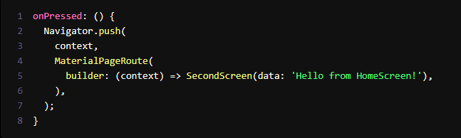
Passing Data Between Screens
In many Flutter applications, you must pass data between screens when navigating to a new page. Flutter provides mechanisms to send and receive data efficiently, ensuring your app functions seamlessly. Let's explore how to accomplish this task.
Sending Data to a New Screen
To send data to a new page, you can pass the data as arguments when navigating. Here's an example of how to send data to the SecondScreen:
In this code snippet, we pass the string 'Hello from HomeScreen!' as data to the SecondScreen by including it in the constructor of SecondScreen.

Slide 16
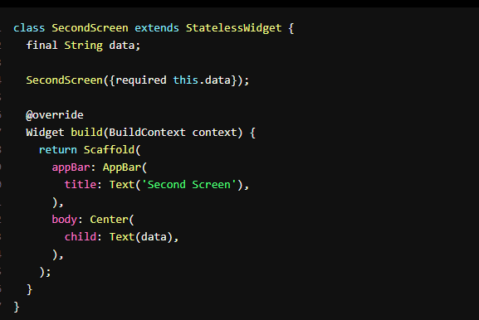
Passing Data Between Screens
Receiving Data on the Destination Page
Now, let's see how to receive the data on the SecondScreen:
In the SecondScreen class, we declare a final field named data to receive the data passed from the HomeScreen. This field is initialized through the constructor.
When you navigate to the SecondScreen, the received data can be used within the build method or anywhere else in the widget's lifecycle.

Slide 17
Navigation Drawer and Tabs
In modern mobile app development, navigation drawers and tabs are popular UI patterns allowing users easy access to various app sections. Flutter makes it straightforward to implement these navigation patterns, enhancing the user experience. Let's dive into how you can integrate navigation drawers and tabs into your Flutter app.
Navigation Drawer
A navigation drawer is a common pattern that displays a menu that can be opened and closed, providing access to different app sections.
Adding Tabs for Navigation
Tabs provide an excellent way to organize content within a single screen and allow users to switch between different sections. Flutter offers the DefaultTabController widget for managing tabs.

Slide 18
What are Stateless Widgets?
A Stateless Widget is one that does not have any mutable state that it needs to track.
The only area of focus of a stateless widget is the information displayed and the user interface.
They deal with situations that are independent of the user’s input.
A Stateless Widget does not tell the framework when to remove it or rebuild it, it gets a command from the framework itself.
They create user interfaces that do not change dynamically upon updating in the nearby values.
We use a stateless widget when we create an application that does not require redrawing a widget again and again.

Slide 19
What are Stateful Widgets?
A Stateful Widget has its own mutable state that it needs to track. It is modified according to the user’s input.
A Stateful Widget looks after two things primarily, the changed state based on its previous state and an updated view of the user interface.
A track of the previous state value has to be looked at because there is a need to self-rebuild the widget to show the new changes made to your application.
A Stateful Widget triggers a build method for creating its children widgets and the subclass of the state holds the related data. It is often used in cases where redrawing of a widget is needed.
A Stateful Widget can change when:
There is a User Input included
There are some User Interaction
There are some Dynamic Changes

Slide 20
Special Methods Associated with Stateful Widget
There are various methods provided by the Stateful class to work with:
BuildContext: It provides information regarding which widget is to be built/re-build and where it will be located after re-building. Thus, BuildContext is the widget associated with the state.
SetState(): A State object is used to modify the user interface. It executes the code for a particular callback and repaints the widgets that rely on that state for configuration.
initState(): This method is the entry point of a widget. The initState() method initializes all the methods that the build method will depend upon. This is called only once in a widget’s lifetime and mostly overridden the rest of the time.
didChangeDependencies(): It is used for loading the dependencies required for execution of a state. The didChangeDependencies() is called immediately after the initState() is called for the first time and before the triggering of the build method.
dispose(): This method is used for removing an object permanently from the widget tree. It is used when we need to clear up the memory by invoking super.dispose().

